Slide 1

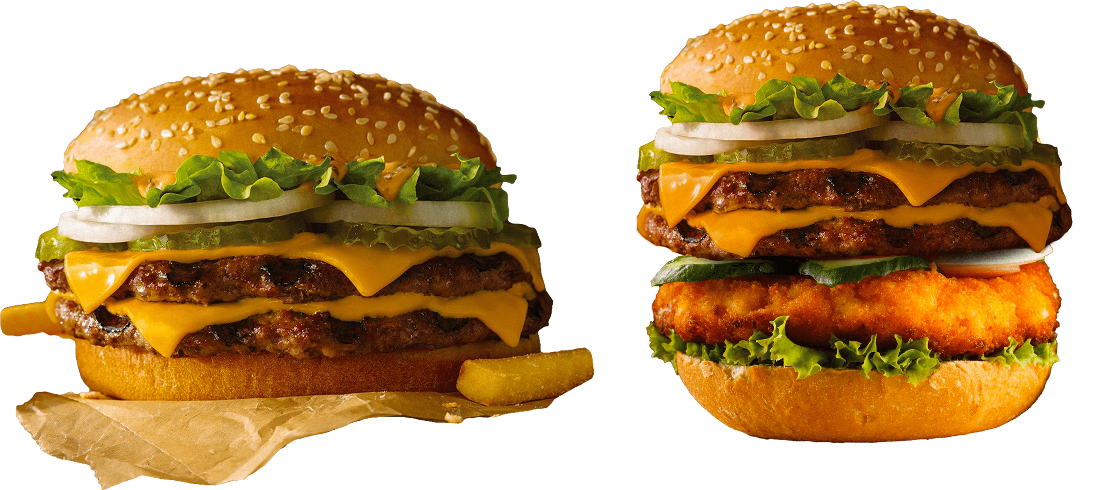
SUGGESTED COUNTRY
AUSTRALIA
CANADA
SINGAPORE
SRI LANKA
ZOMATO
DATA ANALYSIS
NAME - GAURAV SINGH
EMAIL- GAURAVSINGH99984@GMAIL.COM
EXCEL FILE - Zomato_data_project(Gaurav Singh).xlsx DOCS FILE - Zomato_data_task(Gaurav Singh).docs

Slide 2
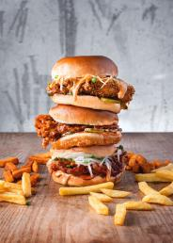

SUGGESTED COUNTRY
AUSTRALIA
CANADA
SINGAPORE
SRI LANKA
INTRODUCTION AND OBJECTIVES
Objectives
Identify potential countries and cities for opening new restaurants.
Analyze key factors influencing restaurant success, including competition, ratings, and cuisine preferences.
Introduction
In a dynamic market, strategic expansion is crucial for sustained growth. This analysis delves into comprehensive data to pinpoint optimal locations, understand market trends, and provide actionable insights for informed decision-making.
Key Components
Objective assessment of countries and cities for new restaurant openings.
In-depth analysis of factors impacting restaurant success.
Recommendations rooted in data-driven insights

Slide 3
SUGGESTED COUNTRY
AUSTRALIA
CANADA
SINGAPORE
SRI LANKA
DATA OVERVIEW
In navigating the vast landscape of our dataset, we encounter a rich tapestry of information encapsulating the essence of our restaurant exploration. Comprising 26 essential attributes, each facet holds a unique key to unraveling insights into the culinary world. From the nuanced nuances of restaurant names and locations to the palpable metrics of ratings, cost, and customer engagement, our data weaves a narrative waiting to be deciphered.
Among the highlights:
Restaurant Identity: Unveiling establishments through distinctive IDs and names.
Geographical Insights: Country codes, city coordinates, and addresses map our gastronomic journey.
Culinary Diversity: The array of cuisines beckoning exploration.
Operational Dynamics: From table bookings to online delivery, we delve into the operational intricacies.
Cost Considerations: Unraveling the cost tapestry with price ranges, average costs, and currency nuances.
Ratings Realm: The qualitative realm of customer feedback and ratings.
Temporal Dimensions: Chronological details, including the opening year, add a historical context.
Global Perspectives: Customized insights into currency conversions and international perspectives.

Slide 4


SUGGESTED COUNTRY
AUSTRALIA
CANADA
SINGAPORE
SRI LANKA
METHODOLOGY
01
Streamlined Approach
Data Cleansing: Thorough cleanup, from city names to format consistency.
Enrichment Strategies: Infusing country descriptions and expanding our dataset.
Analytical Framework: Excel's pivot tables, IF functions, and statistical tools.
02
Toolbox Overview
Statistical Analysis: Uncovering trends and patterns.
Excel Functions: Pivot tables, LOOKUP, logical operators.
Balanced Precision: Technical insights in accessible language.
This concise methodology underpins our analysis, ensuring precision, reliability, and strategic depth.

Slide 5


SUGGESTED COUNTRY
AUSTRALIA
CANADA
SINGAPORE
SRI LANKA
ANALYSIS OF OBJECTIVE QUESTIONS
Data Overview: Explore tables, attributes, and data cleaning steps.
Geographical Insights: Examine restaurant distribution across countries and yearly openings.
Pricing Patterns: Analyze pricing trends and restaurant counts based on price range.
Popularity Metrics: Investigate voter counts and average ratings for key insights.
Conditional Analysis: Explore specific conditions and their impact on restaurant metrics.
Customized Pricing: Understand variations in average cost through customized pricing.
Array Formula Application: Discuss the use of array formulas for complex calculations.

Slide 6
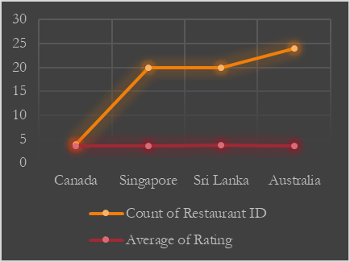




SUGGESTED COUNTRY
AUSTRALIA
CANADA
SINGAPORE
SRI LANKA
COUNTRY SUGGESTION
Analytical Criteria
Utilized Pivot tables with restaurant count and average ratings.
Applied filters for low competition and ratings below 4.
Strategic Insights
Identified regions with both low competition and potential for improvement in average ratings.
Focused on countries where market entry could yield substantial benefits.
SUBJECTIVE ANALYSIS
Additional Insight
Found from Pivot tables that 7 countries have under 25 restaurants, and among them, 4 countries with ratings below 4 were selected, indicating less competition.
AUSTRALIA
CANADA
SINGAPORE
SRI LANKA

Slide 7
SUGGESTED COUNTRY
AUSTRALIA
CANADA
SINGAPORE
SRI LANKA
Selected Cities in Recommended Countries
Australia | Australia | Australia
Armidale, Balingup, Beechworth, Dicky Beach, East Ballina, Flaxton, Forrest Hepburn Springs, Huskisson, Inverloch, Lakes Entrance, Lorn, Macedon, Mayfield Middleton Beach, Montville, Palm Cove, Paynesville, Penola, Phillip Island, Tanunda, Trentham East, Victor Harbor | Armidale, Balingup, Beechworth, Dicky Beach, East Ballina, Flaxton, Forrest Hepburn Springs, Huskisson, Inverloch, Lakes Entrance, Lorn, Macedon, Mayfield Middleton Beach, Montville, Palm Cove, Paynesville, Penola, Phillip Island, Tanunda, Trentham East, Victor Harbor | Armidale, Balingup, Beechworth, Dicky Beach, East Ballina, Flaxton, Forrest Hepburn Springs, Huskisson, Inverloch, Lakes Entrance, Lorn, Macedon, Mayfield Middleton Beach, Montville, Palm Cove, Paynesville, Penola, Phillip Island, Tanunda, Trentham East, Victor Harbor
Armidale, Balingup, Beechworth, Dicky Beach, East Ballina, Flaxton, Forrest Hepburn Springs, Huskisson, Inverloch, Lakes Entrance, Lorn, Macedon, Mayfield Middleton Beach, Montville, Palm Cove, Paynesville, Penola, Phillip Island, Tanunda, Trentham East, Victor Harbor | Armidale, Balingup, Beechworth, Dicky Beach, East Ballina, Flaxton, Forrest Hepburn Springs, Huskisson, Inverloch, Lakes Entrance, Lorn, Macedon, Mayfield Middleton Beach, Montville, Palm Cove, Paynesville, Penola, Phillip Island, Tanunda, Trentham East, Victor Harbor | Armidale, Balingup, Beechworth, Dicky Beach, East Ballina, Flaxton, Forrest Hepburn Springs, Huskisson, Inverloch, Lakes Entrance, Lorn, Macedon, Mayfield Middleton Beach, Montville, Palm Cove, Paynesville, Penola, Phillip Island, Tanunda, Trentham East, Victor Harbor
Armidale, Balingup, Beechworth, Dicky Beach, East Ballina, Flaxton, Forrest Hepburn Springs, Huskisson, Inverloch, Lakes Entrance, Lorn, Macedon, Mayfield Middleton Beach, Montville, Palm Cove, Paynesville, Penola, Phillip Island, Tanunda, Trentham East, Victor Harbor | Armidale, Balingup, Beechworth, Dicky Beach, East Ballina, Flaxton, Forrest Hepburn Springs, Huskisson, Inverloch, Lakes Entrance, Lorn, Macedon, Mayfield Middleton Beach, Montville, Palm Cove, Paynesville, Penola, Phillip Island, Tanunda, Trentham East, Victor Harbor | Armidale, Balingup, Beechworth, Dicky Beach, East Ballina, Flaxton, Forrest Hepburn Springs, Huskisson, Inverloch, Lakes Entrance, Lorn, Macedon, Mayfield Middleton Beach, Montville, Palm Cove, Paynesville, Penola, Phillip Island, Tanunda, Trentham East, Victor Harbor
Canada | Canada | Canada
Chatham Consort Vineland Station Yorkton | Chatham Consort Vineland Station Yorkton | Chatham Consort Vineland Station Yorkton
Chatham Consort Vineland Station Yorkton | Chatham Consort Vineland Station Yorkton | Chatham Consort Vineland Station Yorkton
Chatham Consort Vineland Station Yorkton | Chatham Consort Vineland Station Yorkton | Chatham Consort Vineland Station Yorkton
Analytical Criteria
Utilized Pivot tables at the city level for detailed analysis.
Applied filters for low competition and ratings less than 4 within the suggested countries.
Strategic Insights
Singapore | Singapore | Singapore
Singapore | Singapore | Singapore
Singapore | Singapore | Singapore
Singapore | Singapore | Singapore
Selected cities aligning with the overall country criteria.
Aimed for a balanced city selection strategy based on data analysis.
Additional Insight
Identified cities meeting the criteria for potential market entry.
Ensured a strategic balance in city choices within the recommended countries.
Sri Lanka | Sri Lanka | Sri Lanka
Colombo | Colombo | Colombo
Colombo | Colombo | Colombo
Colombo | Colombo | Colombo

Slide 8
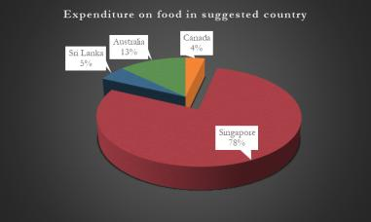
SUGGESTED COUNTRY
AUSTRALIA
CANADA
SINGAPORE
SRI LANKA
ANALYZING FOOD EXPENDITURE IN TARGET REGIONS
Analytical Approach:
Utilized data from "Raw Data" sheet.
Applied SUMIF formula for aggregating expenditure on food.
Converted local currencies to USD for uniformity.
Visualization
Include a pie chart and table showcasing the expenditure breakdown for visual clarity
Expenditure on food in suggested country | Expenditure on food in suggested country
Canada | $107.30
Singapore | $2,305.10
Sri Lanka | $152.00
Australia | $375.70

Slide 9
SUGGESTED COUNTRY
AUSTRALIA
CANADA
SINGAPORE
SRI LANKA
Few Restaurant Name | Few Restaurant Name | Few Restaurant Name
COMPETITOR ANALYSIS
UNDERSTANDING THE COMPETITION
HIGH Competition
Lake House Restaurant
Al'frank Cookies
Ministry of Crab
Bridge Road Brewers
Moderate Competition
Tokyo Sushi
Summer Pavilion
Cafe Shaze
Blue Bean Love Cafe
Analytical Criteria
Utilized Pivot tables at the restaurant level for detailed analysis.
Applied filters the suggested countries.
Strategic Insights
Selected restaurant having greater than 4 average rating as High competitor, 3 to 4 average rating consider as moderate and below 3 average rating consider as Low competitor.
Low Competition
Queen's Cafe
Star Buffet

Slide 10




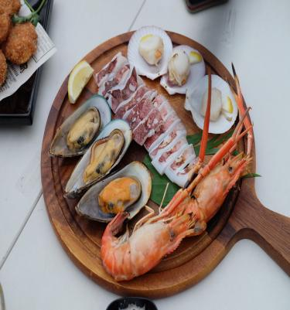
SUGGESTED COUNTRY
AUSTRALIA
CANADA
SINGAPORE
SRI LANKA
CUISINES ANALYSIS
CUISINES WITH TOP RATINGS
CUISINES
Culinary choices wield significant influence on ratings, as evidenced by a two-step analysis. The first pivot table dissects country-specific restaurant ratings, guiding adaptation to local preferences. Simultaneously, the second pivot table provides a broader global perspective, underlining the pivotal role of culinary choices in shaping customer satisfaction.
Pizza
Mediterranean
Australian
Italian
Chinese
Bakery
Seafood
American
Continental
Desserts
Beverages

Slide 11
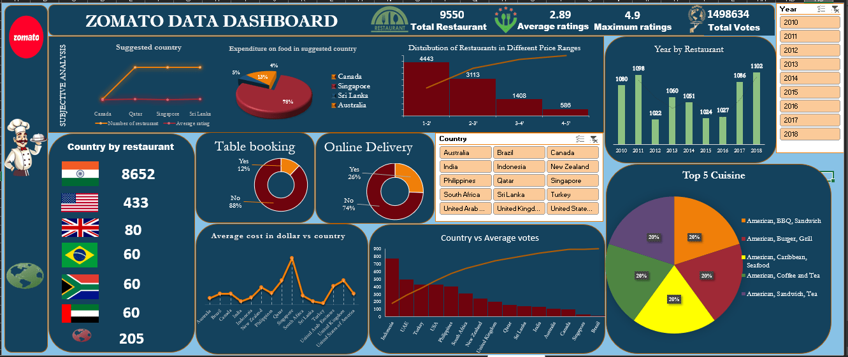
SUGGESTED COUNTRY
AUSTRALIA
CANADA
SINGAPORE
SRI LANKA
DASHBOARD

Slide 12


SUGGESTED COUNTRY
AUSTRALIA
CANADA
SINGAPORE
SRI LANKA
THANK YOU

